Slide 1
Create an Amazon Echo clone
Anthony, Arnaud, Aylin, Josué

Slide 2
Goals
Create an Amazon echo clone with cheap materials
Create a simple skill
Create a skill to scrap the linkedin account
Create a skill to make the coffee

Slide 3
Tools
Raspberry Pi 3 with his MicroSD card
Amazon Developer Console
USB Mic/ Speaker
Case built from the 3D printer (found on thingeverse)
A Macbook Pro (3800Eur)

Slide 4
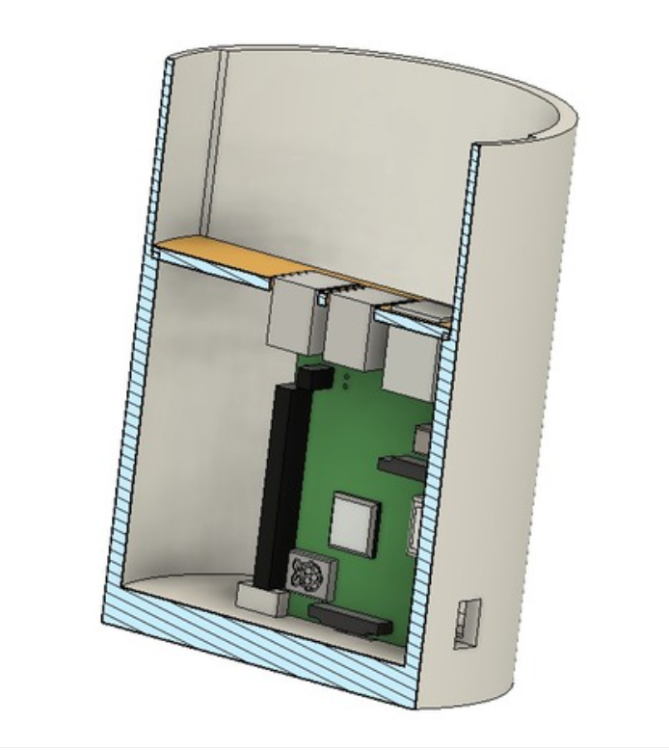
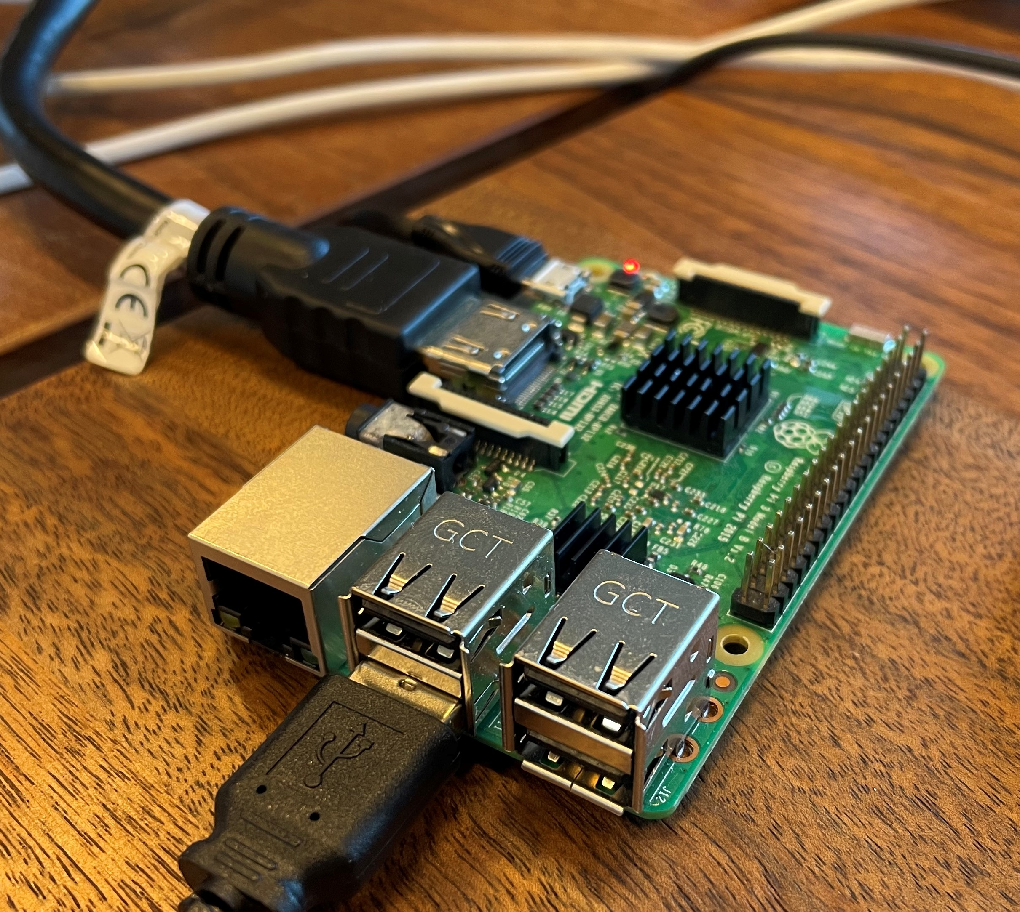
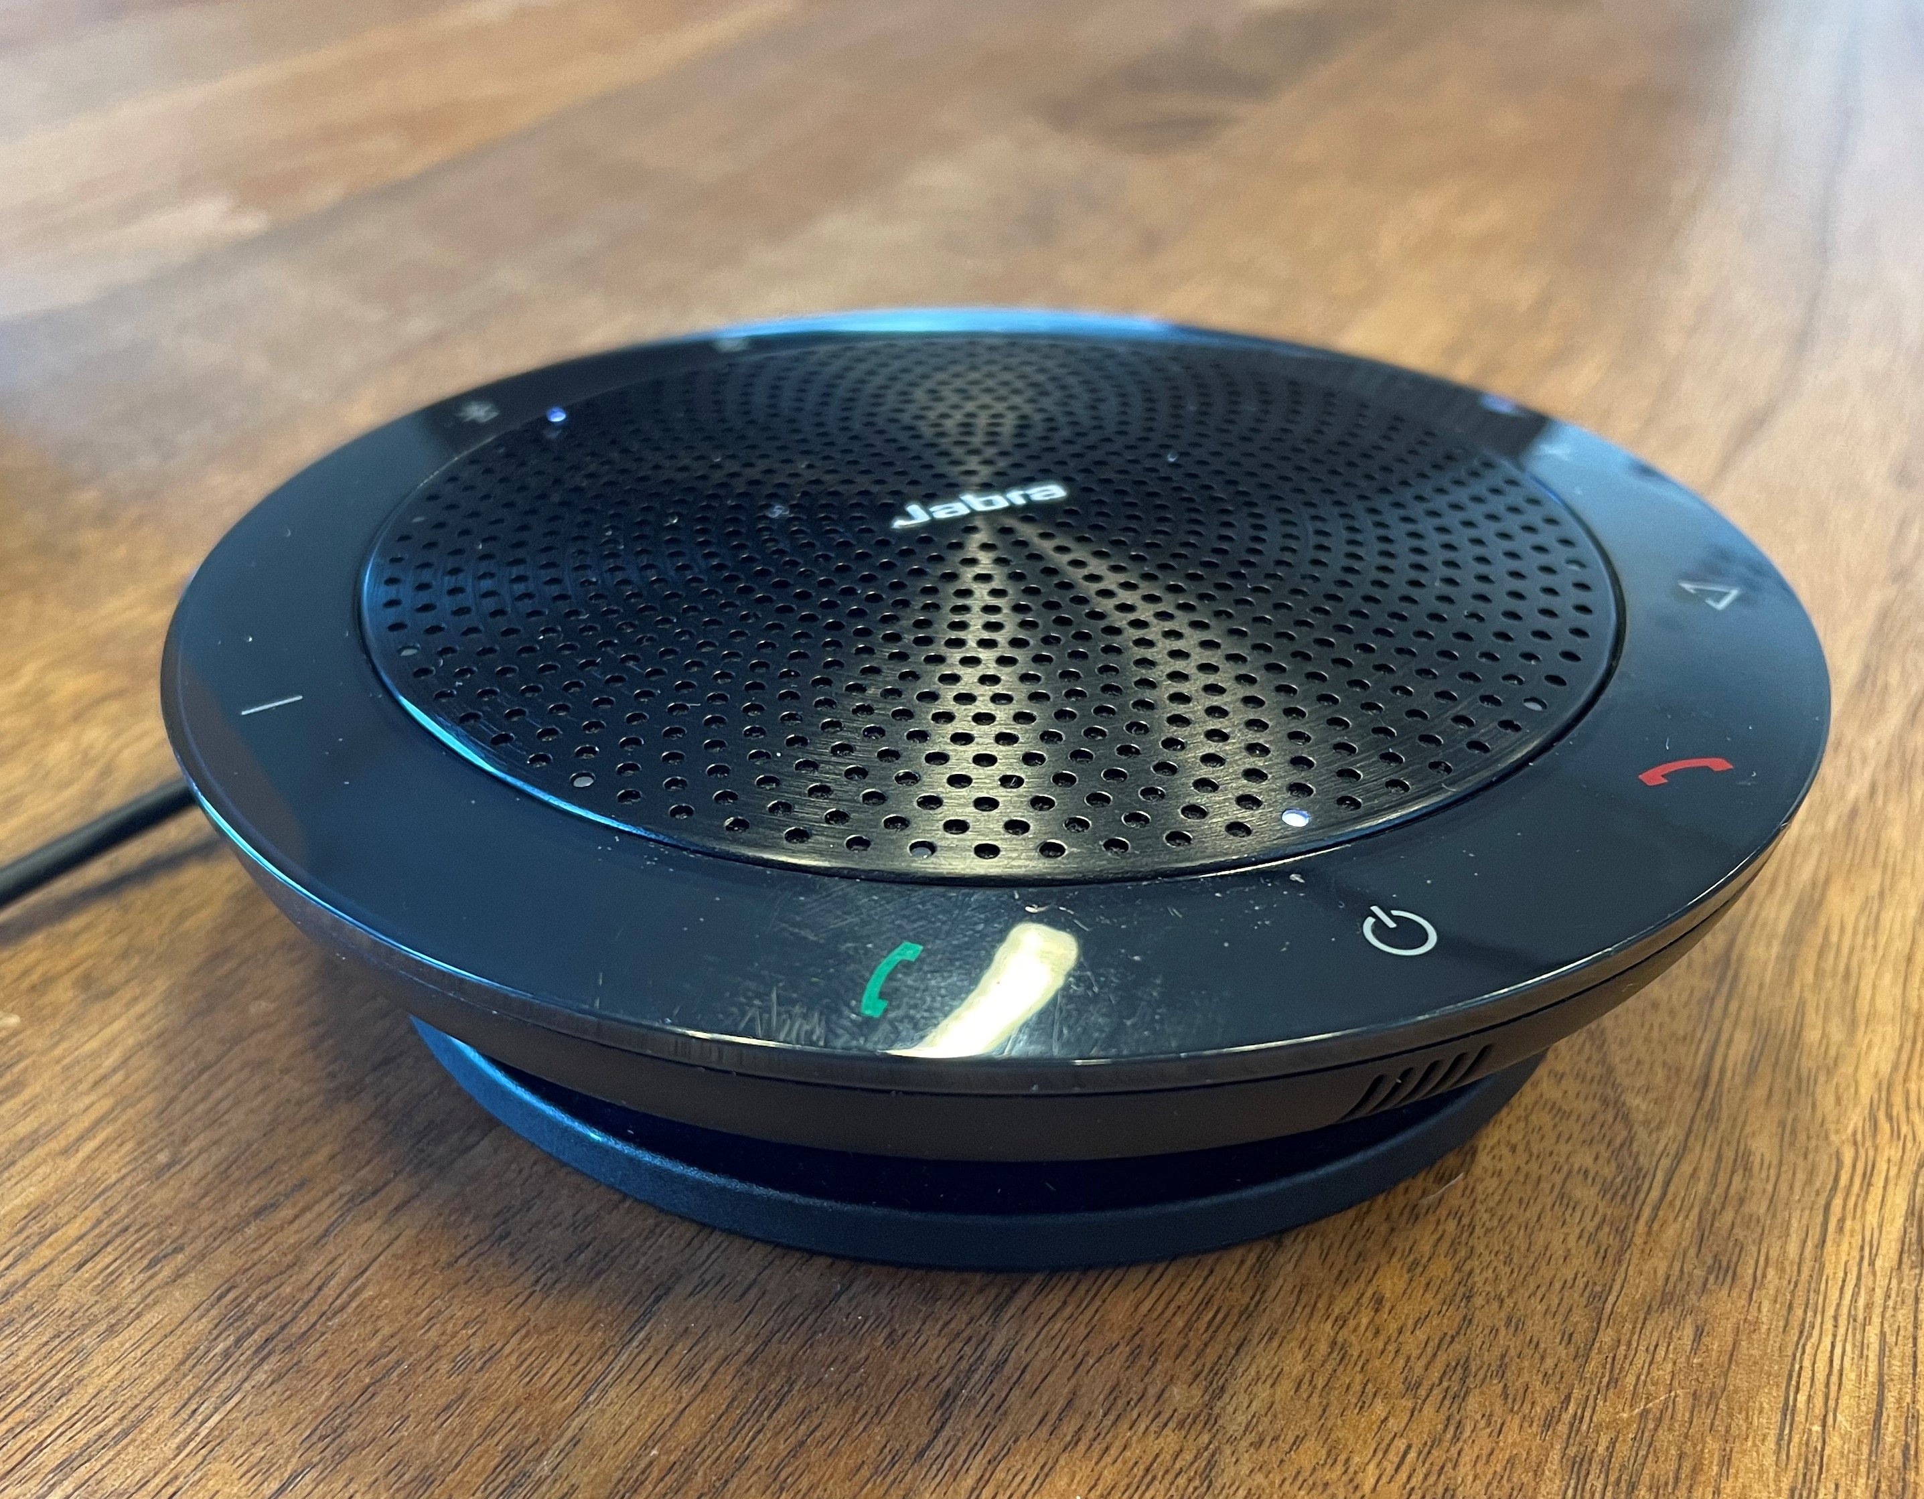
Tools

Slide 5
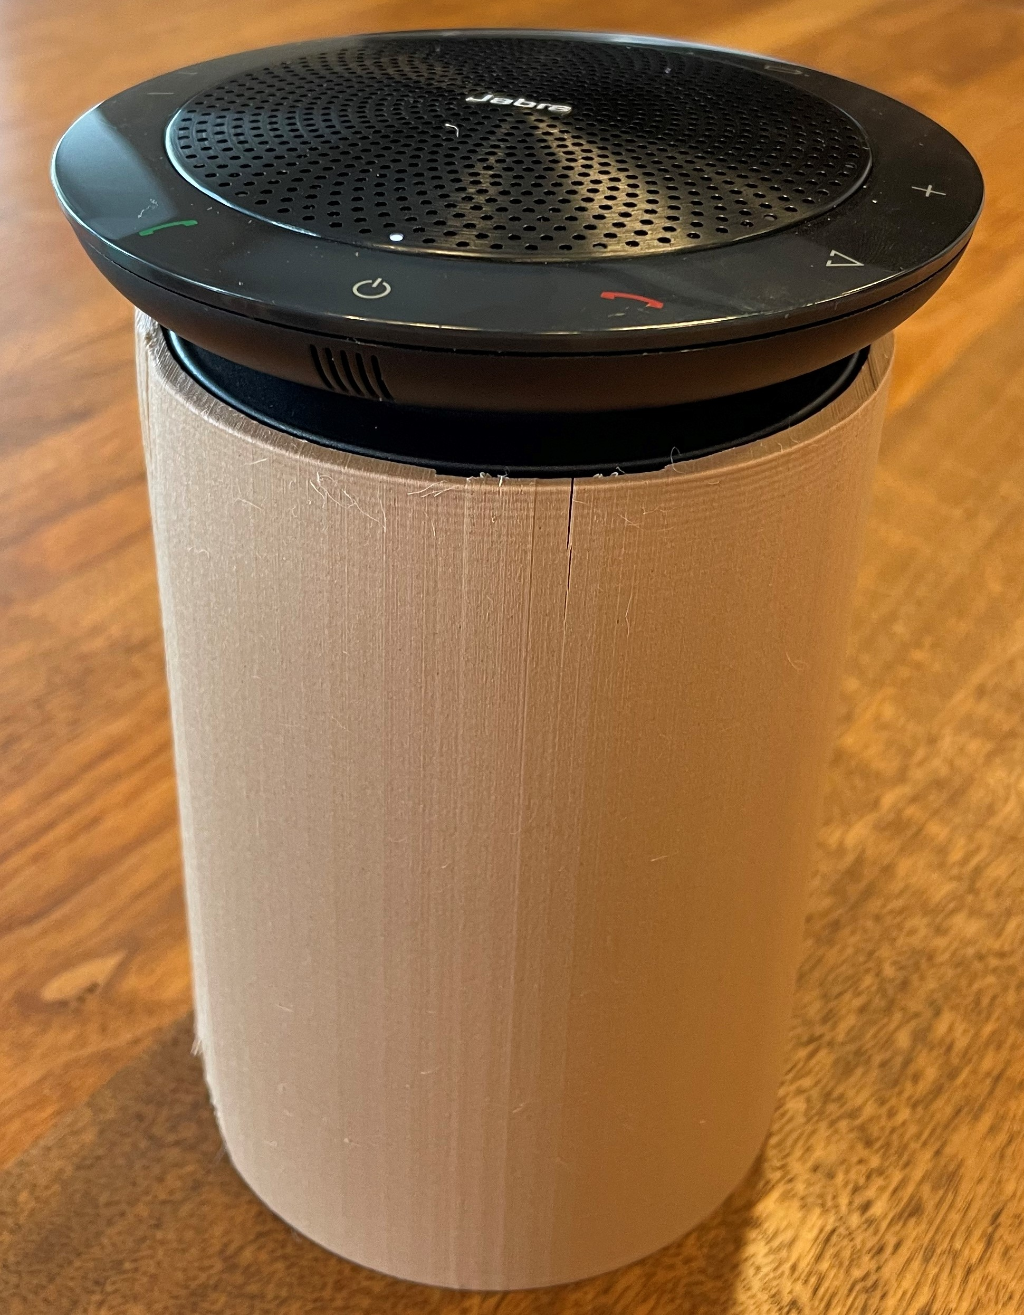
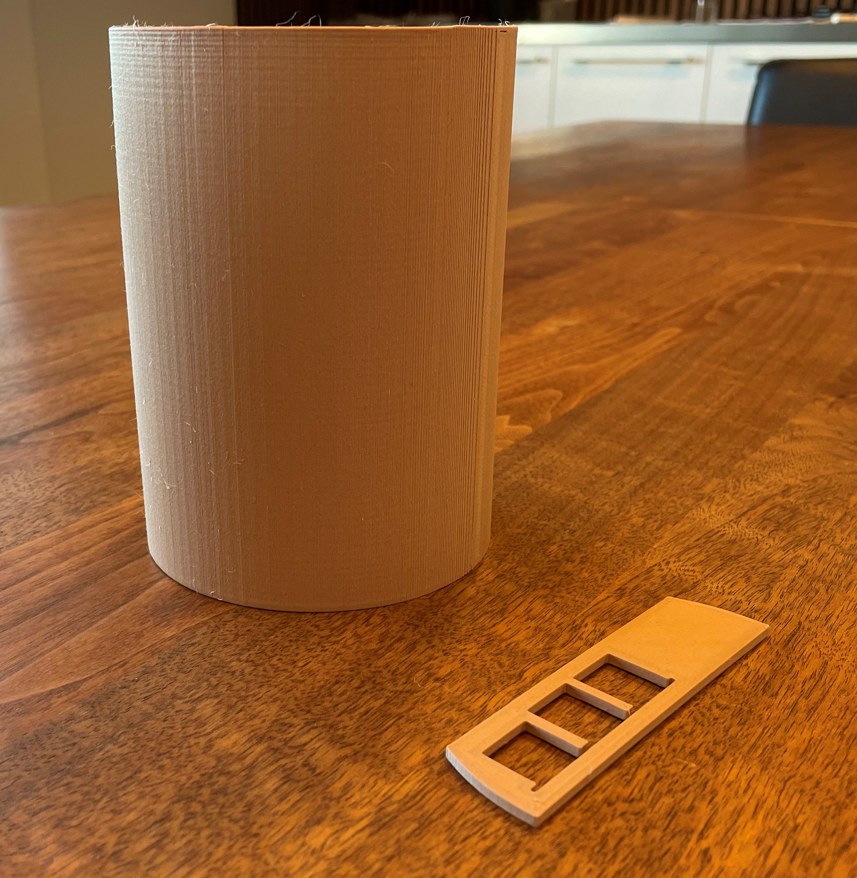
Tools

Slide 6
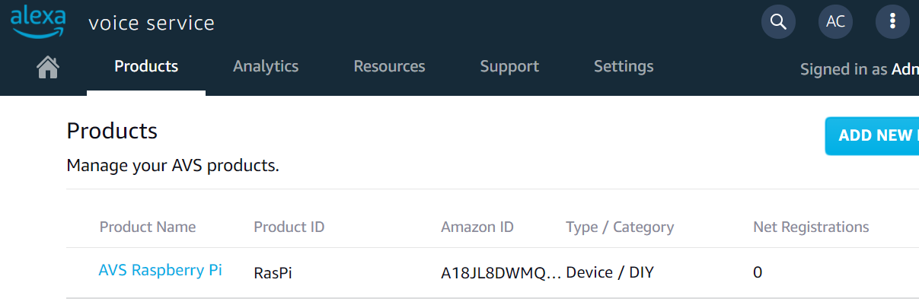
Usage
You first need an Amazon Developper Account + AWS Account
Register the DIY product as an AVS product, this will give an AWS ID

Slide 7
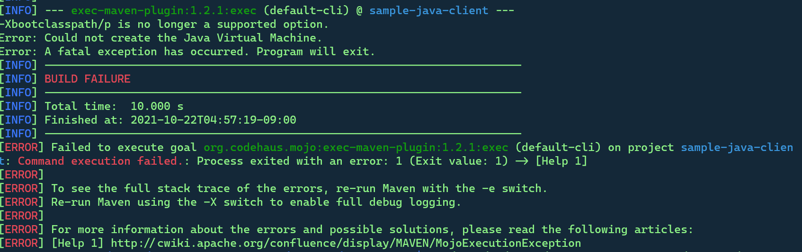
Configure the Pi with Raspbian Buster
Allow the SSH to remote access it
Install all dependencies
Then download and build the SDK
And finally run the app

Slide 8
Code

Slide 9
Growth feedback
Logs are not clear
Documentation is not up to date
It’s not cheaper as expected

